Slide 1
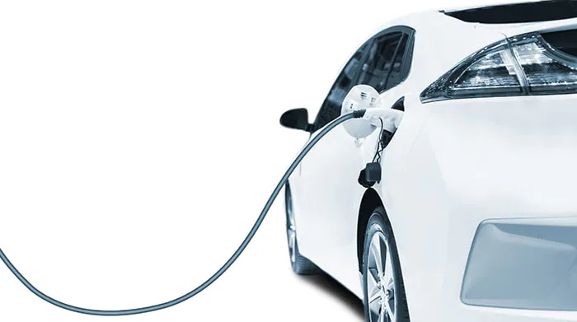


Heading towards a green future.
Team Members
Dhruy Pandit
Husan Ara
Ivan Sheungching Chan
Jet Hong Low
Kia Tabandeh Tehrani
Muhammad Ahmad
Virroshan Kumar
Notes:
-Hello, we are team chargeit at govhack hackathon 2023

Slide 2
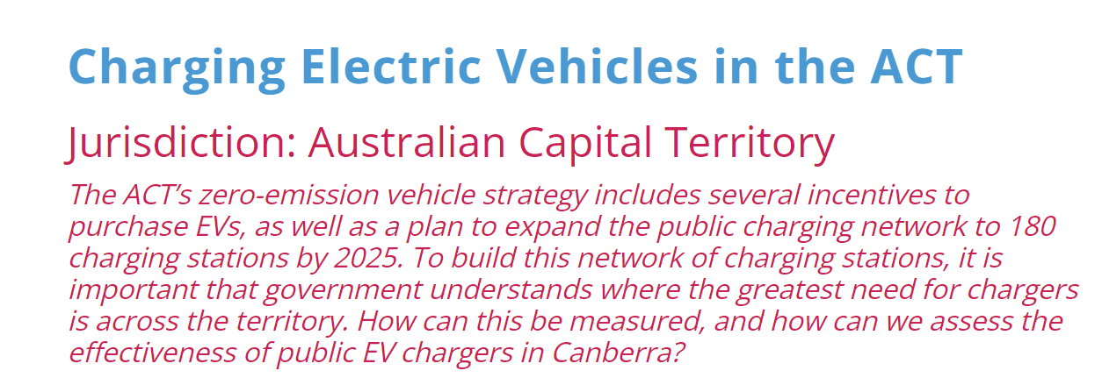
THE CHALLENGE WE HAVE CHOSEN
Notes:
We’ve chosen the charging electric vehicles in the ACT challenge and focused on two issues.

Slide 3
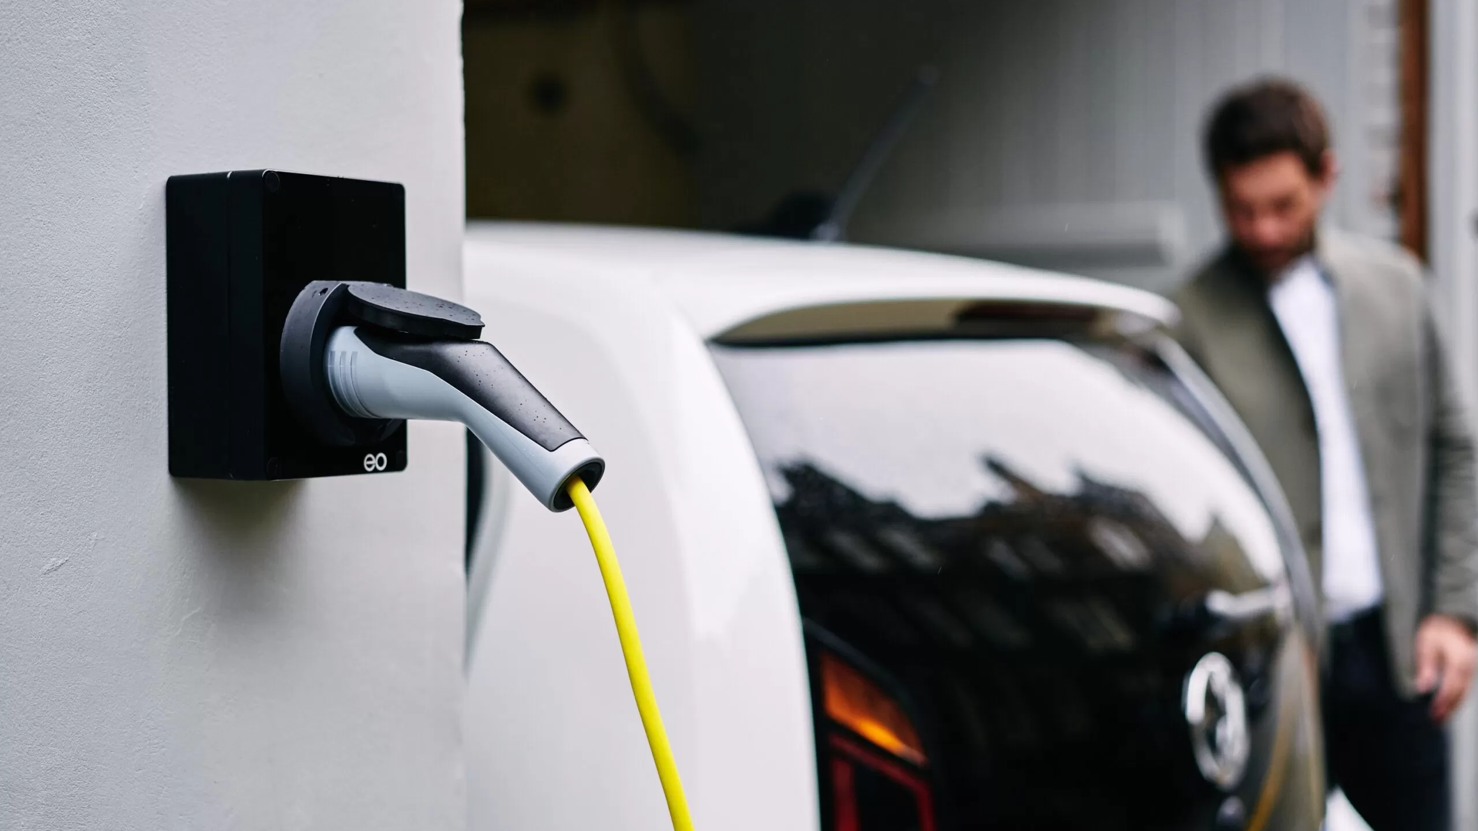
CHALLENGES
1
2
How can we plan a distribution network of 180 EV charging stations throughout ACT by 2025?
Lack of past and current data collection
Notes:
How can we plan a distribution network of 180 EV charging stations throughout ACT by 2025, and how can we fix the lack of past and current data collection around EV driver habits, as proposed by the ACT government

Slide 4
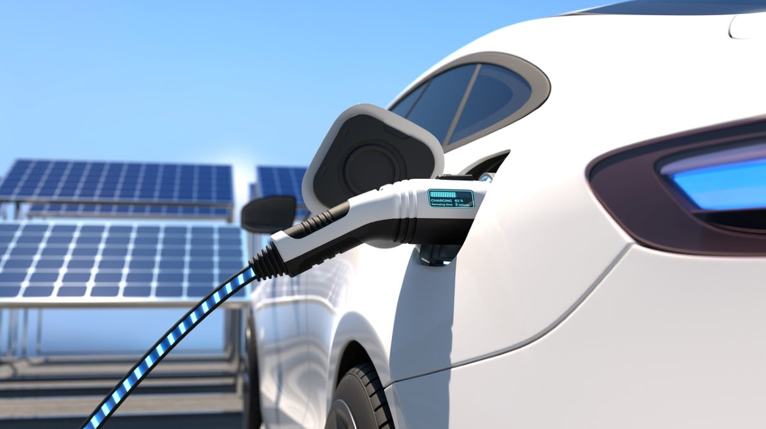
WHY?
Preparation for EV community growth
Educating EV users
Providing a better EV experience
Notes:
We’ve chosen this challenge to prepare the EV community for growth, create awareness and education for current and future EV users, and provide a better EV experience for users, something that is a current pain point in the industry.

Slide 5
OUR SOLUTIONS
A map of current ready hotspots for charging stations based on datasets
An app used to collect data on EV driver behaviours whilst enhancing the EV owner experience
Notes:
We've created two solutions for the problems respectively. A map of the current hotspots ready to go for charging stations, and the ChargeIt app, which is used to collect the EV driver behaviours, whilst enhancing the user experience.

Slide 6

EV Charging Station Sites Criteria
EV Vehicle Growth Done
Population Density
Earning Capacity Per
Power Grid Network Support
Interstate Travel / Long Distance travel
Access to Utilities
Safer and Well Lit
Current EV chargers’ Density / Network available / EVs per Charging Station
Data from ChargeIt app for EV Driver Behaviour
Sustainable Power Sources (renewable or accessible)
Regular Maintenance
Notes:
Seen here is the criteria we have created based on a firsthand user experience of an electric vehicle

Slide 7
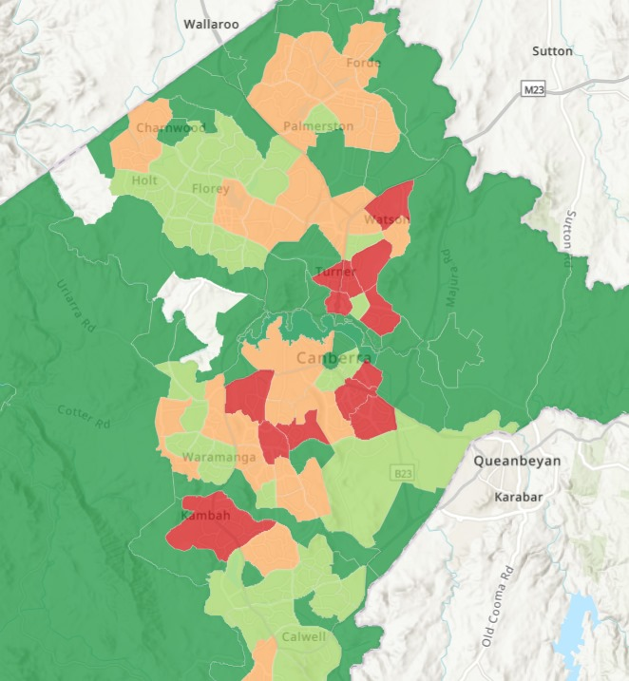
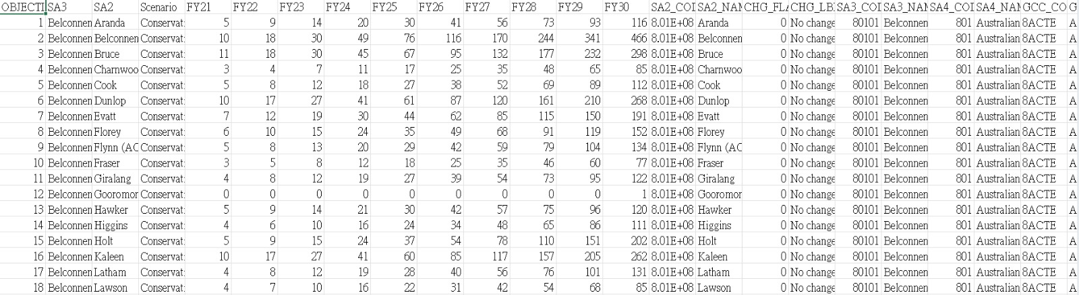
EV Registration Map
Source provided by GovHack Challenge:
Data Set 2: Electric Vehicles Registration Number (ACT Government)
Provided by the GovHack Challenge:Electric Vehicles Registration Number
(https://actmapi-actgov.opendata.arcgis.com/datasets/ACTGOV::electric-vehicles-registration-number/about)
Notes:
We have uses the data set on the left and display it onto the Map of ACT by highlighting the Suburbs with didferent colours to represent the number or EV registrations in the area

Slide 8
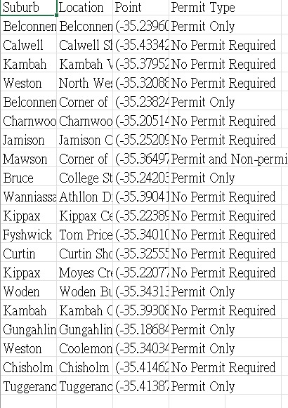
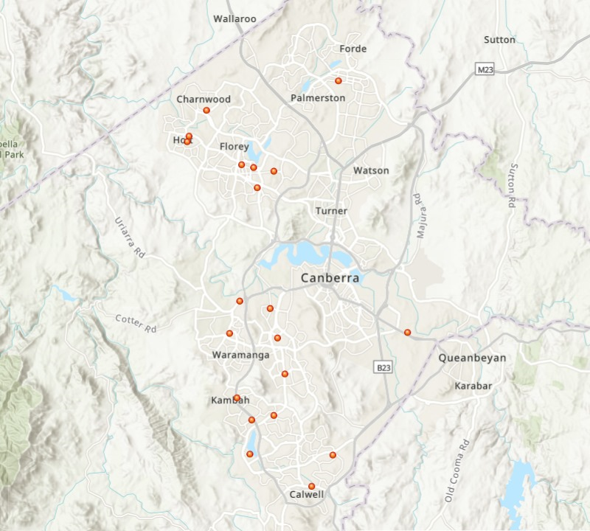
Park & Ride Map
Source: plugshare.com (Shows location of current EV charging stations)
(https://actmapi-actgov.opendata.arcgis.com/datasets/ACTGOV::electric-vehicles-registration-number/about)
Notes:
Lack of data on driver behaviour
Lack of current data tracking programs
Lack of data collection by government

Slide 9
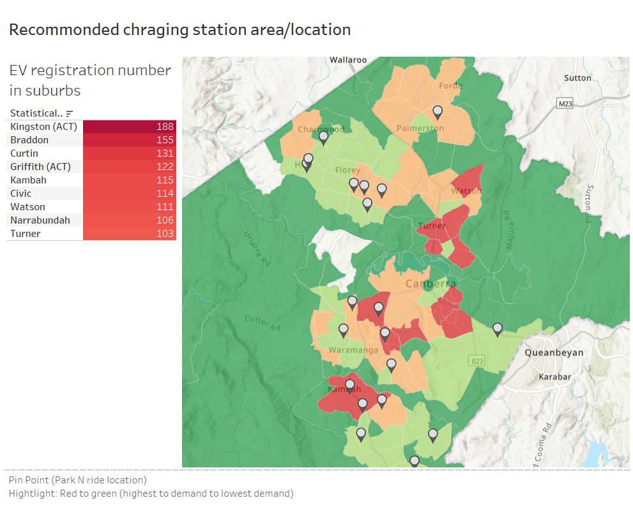
Source: ACT Government
Notes:
This is the recommended charging area ad location as pinpointed in the maps
The highlighted show where the demanding areas are based on the EV registration dataset
Red is highest demanding area and flowed by yellow and green with the least
The pointed are is the accurate suggested charging locations

Slide 10
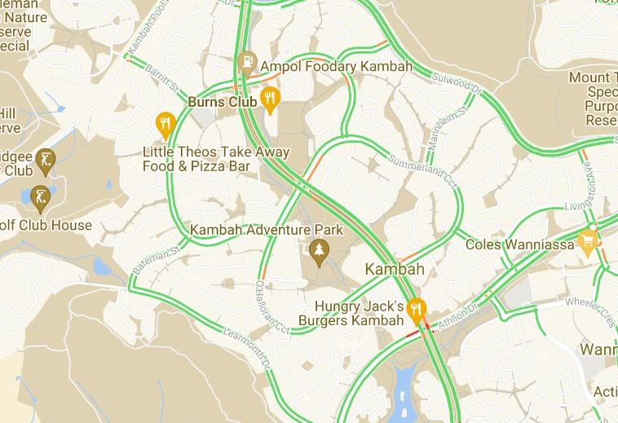
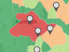
Example of high demand areas
Source: plugshare.com (Shows location of current EV charging stations)
Kambah
One of the largest EV registered area
No existing charging station
Busy Area - Three ‘Park N ride’ location
Notes:
Kambah is the most demanding are as
- Explain charging station map and you can see

Slide 11

Pain points with the current solution
Notes:
Not enough data on driver behaviours mentioned before
Not regularly update
Not maintained
Unreliable data
Which is why we have creaed the ChargeIt application

Slide 12

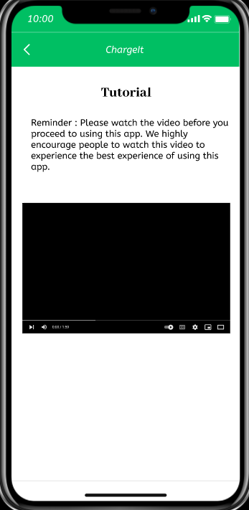
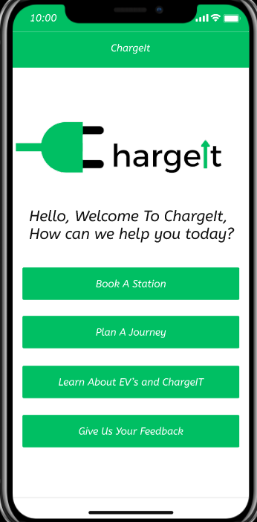
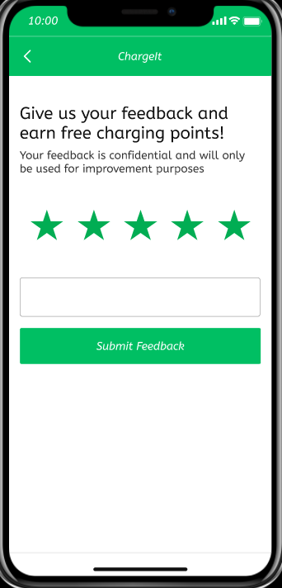
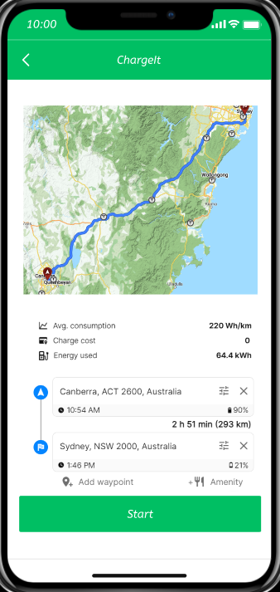

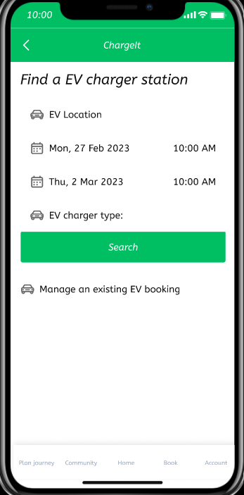
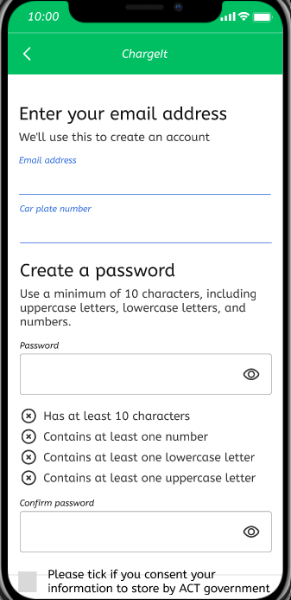
Notes:
The purpose of the chargeit app is to
educate, collect data, and simplify the EV user experience, similar to what TESLA has achieved
Seen here is a prototype of the application
Map and app are interconnected
The data collected by the app is used to make the existing network of charging stations more efficient. In addition, the app is gamified in order to create a loyal customer base.

Slide 13
Data to be collected from App
Which charging station they are using? How often they visit charging station?
How much time they spent at the charging station?
Which one is the busiest charging station?
When charging stations are busy during day?
Feedback from app user regarding charging station.
What are common routes that Electric Vehicle drivers are utilizing?
Notes:
Which charging stations are being visited, how often, how much time is spent.
WHich station's the busiest, what feedback is received, and what are most common routes of EV users?

Slide 14
TIMELINE
What's already been done
Maintenance & Optimization
Data Collection & Analysis
Station Placement Strategy
2023
2024
2023
2025
Assessment of Pain-points and Station Types
2023
Infrastructure Dev. & Implementation
Goal checkpoint and future considerations
Notes:
THis is the timeline of our solution for the challenge, including future considerations

Slide 15
FUTURE WORKS
Marketing the solution
Integrating with PlugShare
Prebooking Algorithm
Creating a wider reach (expanding nationwide)
Releasing and testing prototype
Notes:
And these are the future works
Future works will include marketing, ingeration with plugshare, prebooking algorithm , expansion, and testing of prototype

Slide 16

Brought to you by:
From top right to left
Dhruy Pandit
Muhammad Ahmad
Husan Ara
Virroshan Kumar
Jet Hong Low
Bottome left to right
Ivan Sheungching Chan
Kia Tabandeh Tehrani
Notes:
Thank you from the ChargeIt team.

